Slide 1
C# Basic concepts
Variables, operators, expressions

Slide 2
Data Types

Slide 3
Data type
A data type:
Is a domain of values of similar characteristics
Defines the type of information stored in the computer memory (in a variable)
A data type has:
Name (C# keyword or .NET type)
Size (how much memory is used)
Default value
Example:
Name int (Int32), Size 32 bits, Default value 0

Slide 4
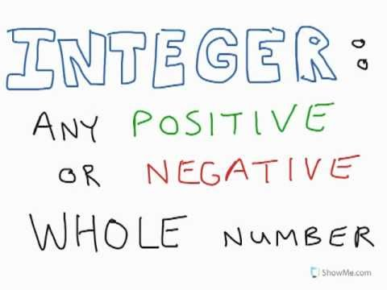
Integer types
sbyte (-128 to 127): signed 8-bit
byte (0 to 255): unsigned 8-bit
short (-32,768 to 32,767): signed 16-bit
ushort (0 to 65,535): unsigned 16-bit
int (-2,147,483,648 to 2,147,483,647): signed 32-bit
uint (0 to 4,294,967,295): unsigned 32-bit
long (-9,223,372,036,854,775,808 to 9,223,372,036,854,775,807): signed 64-bit
ulong (0 to 18,446,744,073,709,551,615): unsigned 64-bit

Slide 5
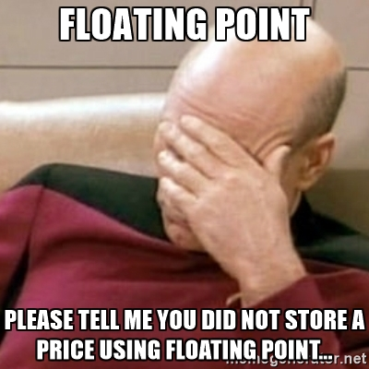
Floating point types
Floating-point types are:
float (±1.5 × 10⁻⁴⁵ to ±3.4 × 10³⁸)
32-bits, precision of 7 digits
double (±5.0 × 10⁻³²⁴ to ±1.7 × 10³⁰⁸)
64-bits, precision of 15-16 digits
The default value of floating-point types:
Is 0.0F for the float type
Is 0.0D for the double type
Real numbers are by default interpreted as double!

Slide 6
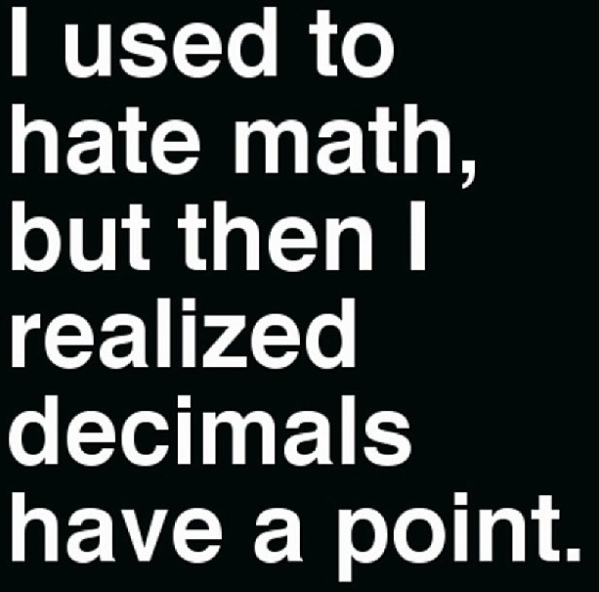
Decimal type
There is a special decimal floating-point real number type in C#:
decimal (±1,0 × 10⁻²⁸ to ±7,9 × 10²⁸)
128-bits, precision of 28-29 digits
Used for financial calculations
No round-off errors
Almost no loss of precision
The default value of decimal type is:
0.0M (M is the suffix for decimal numbers)

Slide 7

Boolean type
The Boolean data type:
Is declared by the bool keyword
Has two possible values: true and false
Is useful in logical expressions
The default value is false

Slide 8
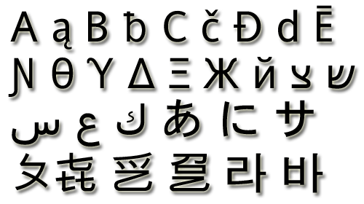
Character type
The character data type:
Represents symbolic information
Is declared by the char keyword
Gives each symbol a corresponding integer code
Has a '\0' default value
Takes 16 bits of memory (from U+0000 to U+FFFF)
Holds a single Unicode character (or part of character)

Slide 9

String type
The string data type:
Represents a sequence of characters
Is declared by the string keyword
Has a default value null (no value)
Strings are enclosed in quotes:
Strings can be concatenated
Using the + operator
string s = "Hello, C#";

Slide 10

Object and dynamic types
The object type:
Is declared by the object keyword
Is the base type of all other types
Can hold values of any type
The dynamic type:
behaves like type object in most circumstances
expressions of type dynamic are not resolved or type checked by the compiler
exists only at compile time, not at run time
… a kitten dies every time you use dynamic

Slide 11
Nullable types
Nullable types are instances of the System.Nullable structure
Wrapper around the primitive types
E.g. int?, double?, etc.
Nullable type can represent the normal range of values for its underlying value type, plus an additional null value
Useful when dealing with databases or other structures that have default value null

Slide 12
Implicit Type Conversion
Implicit type conversion
Automatic conversion of value of one data type to value of another data type
Allowed when no loss of data is possible
"Larger" types can implicitly take values of smaller "types"
Example:
int i = 5;
long l = i; // implicit type conversion

Slide 13
Explicit Type Conversion
Explicit type conversion
Manual conversion of a value of one data type to a value of another data type
Allowed only explicitly by (type) operator
Required when there is a possibility of loss of data or precision
Example:
long l = 5;
int i = (int) l; // explicit type conversion

Slide 14
Variables

Slide 15
What Is a Variable
Variables keep data in the computer memory
A variable is a:
Placeholder of information that can be changed at run-time
Variables allow you to:
Store information
Retrieve the stored information
Change the stored information

Slide 16

Variable characteristics
counter
A variable has:
Name
Type (of stored data)
Value
Example:
Name: counter
Type: int
Value: 5
5
int

Slide 17
Identifiers
Identifiers may consist of:
Letters (Unicode)
Digits [0-9]
Underscore "_"
Examples: count, firstName, Page
Identifiers
Can begin only with a letter or an underscore
Cannot be a C# keyword (like int and class)

Slide 18

Identifiers
Identifiers
Should have a descriptive name
E.g. firstName, not dasfas or p17
It is recommended to use only Latin letters
Should be neither too long nor too short
Note:
In C# small letters are considered different than the capital letters (case sensitivity)

Slide 19
Initializing Variables
Initializing
Means "to assign an initial value"
Must be done before the variable is used!
Several ways of initializing:
By using the new keyword
By using a literal expression
By referring to an already initialized variable

Slide 20
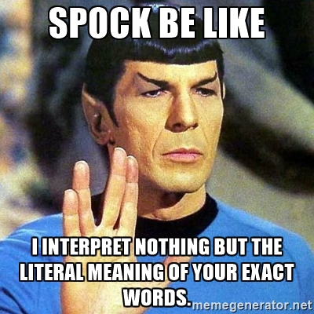
Literals
Literals are:
Representations of values in the source code
There are several types of literals
Boolean
Integer
Real
Character
String
The null literal

Slide 21

Types and Variables Demo

Slide 22
Operators and Expressions

Slide 23
Operators and expressions
Operator is an operation performed over data at runtime
Takes one or more arguments (operands)
Produces a new value
Example of operators:
Operators have precedence
Precedence defines which will be evaluated first
Expressions are sequences of operators and operands that are evaluated to a single value, e.g. (a + b) / 2
Operator "+"
a = b + c;
Operator "="

Slide 24
Operators in C#
Category | Operators
Arithmetic | + - * / % ++ --
Logical | && || ^ !
Binary | & | ^ ~ << >>
Comparison | == != < > <= >=
Assignment | = += -= *= /= %= &= |= ^= <<= >>=
String concatenation | +
Type conversion | is as typeof
Other | . [] () ?: new

Slide 25
Operators Precedence
Precedence | Operators
Highest | ()
 | ++ -- (postfix) new typeof
 | ++ -- (prefix) + - (unary) ! ~
 | * / %
 | + -
 | << >>
 | < > <= >= is as
 | == !=
 | &
Lower | ^

Slide 26
Operators Precedence
Precedence | Operators
Higher | |
 | &&
 | ||
 | ?:
Lowest | = *= /= %= += -= <<= >>= &= ^= |=
Parenthesis operator always has highest precedence
Note: prefer using parentheses, even when it seems stupid to do so

Slide 27
Arithmetic Operators
Arithmetic operators +, -, * are the same as in math
Division operator / if used on integers returns integer (without rounding) or exception
Division operator / if used on real numbers returns real number or Infinity or NaN
Remainder operator % returns the remainder from division of integers
The special addition operator ++ increments a variable
Beware of Integer Division!!!
When you divide two integers, the result is always an integer.
To determine the remainder use the remainder operator %.
Cast the dividend or divisor to type float or double

Slide 28
Logical operators
Logical operators take boolean operands and return boolean result
Operator ! turns true to false and false to true
Behavior of the operators &&, || and ^ (1 == true, 0 == false):
Operator | || | || | || | || | && | && | && | && | ^ | ^ | ^ | ^
Operand1 | 0 | 0 | 1 | 1 | 0 | 0 | 1 | 1 | 0 | 0 | 1 | 1
Operand2 | 0 | 1 | 0 | 1 | 0 | 1 | 0 | 1 | 0 | 1 | 0 | 1
Result | 0 | 1 | 1 | 1 | 0 | 0 | 0 | 1 | 0 | 1 | 1 | 0

Slide 29

Comparison and Assignment Operators
Comparison operators are used to compare variables
==, <, >, >=, <=, !=
Assignment operators are used to assign a value to a variable ,
=, +=, -=, |=, ...

Slide 30
Other operators
String concatenation operator + is used to concatenate strings
If the second operand is not a string, it is converted to string automatically
Member access operator . is used to access object members
E.g. DateTime.Now.DayOfWeek.ToString()
Square brackets [] are used with arrays, indexers and attributes
E.g. numbers[3], "Hello"[2]
Parentheses ( ) are used to override the default operator precedence, e.g. (a + b) / 2
Class cast operator (type) is used to cast one compatible type to another, e.g. (uint) 1

Slide 31
Other operators
Conditional operator ?: has the form
(if b is true then the result is x else the result is y)
The new operator is used to create new objects
The typeof operator returns System.Type object (the reflection of a type), e.g. typeof(int)
The is operator checks if an object is compatible with given type, e.g. 5 is int → true; 3.14 is float → false
b ? x : y

Slide 32
Other operators
Null-coalescing operator ?? is used to define a default value for both nullable value types and reference types
It returns the left-hand operand if it is not null
Otherwise it returns the right-hand operand
Here the value of y is -1
int? x = null;
int y = x ?? -1;
int? x = 1;
int y = x ?? -1;
Here the value of y is 1

Slide 33
Expressions
Expressions are sequences of operators, literals and variables that are evaluated to some value
Expression of type int. Calculated at compile time
Expression of type int. Calculated at runtime
int a = 2 + 3; // a = 5
int b = (a + 3) * (a - 4) + (2 * a + 7) / 4; // b = 12
bool greater = (a > b) || ((a == 0) && (b == 0));
Expression of type bool. Calculated at runtime

Slide 34

Operators and Expressions Demo

Slide 35

Any questions

